Slide 1
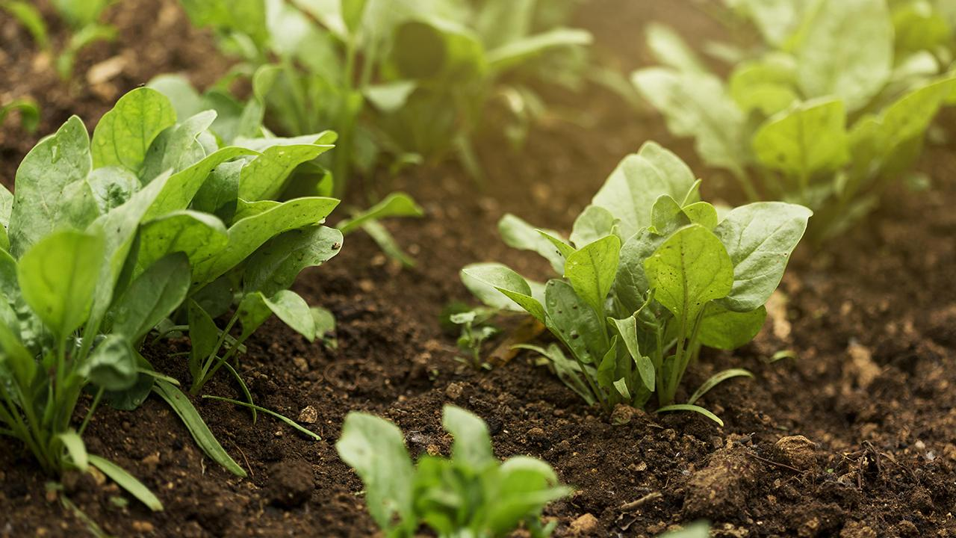

Soil Management using IoT and ML
An end-to-end solution for assisting farmers

Slide 2
Do you know(Problem Statement)?
10,600 farmers commit suicide every year due to crop failure.
By 2050, 90% of the soil will be Degraded.
Changing from chemical to organic farming requires 2-3 years of time for soil to adapt.
Nearly 27,000 species go extinct every year due to soil degradation.

Slide 3
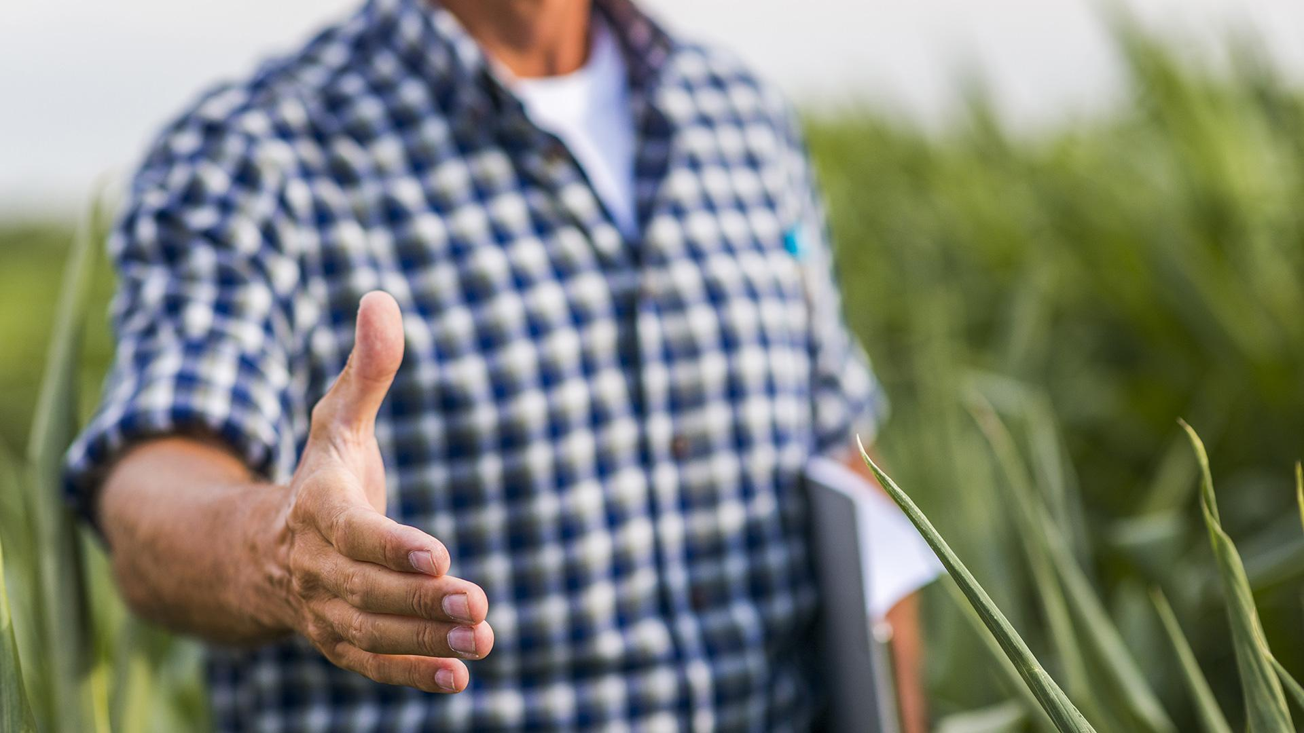
01
MATNURE
We can help you solve all these problems organically and alongside farmers

Slide 4

Introduction
We aim to Digitalize farms by building up new Agri-Tech solutions to the market which will be surely important for human sustainability and for the health of our future generations.

Slide 5
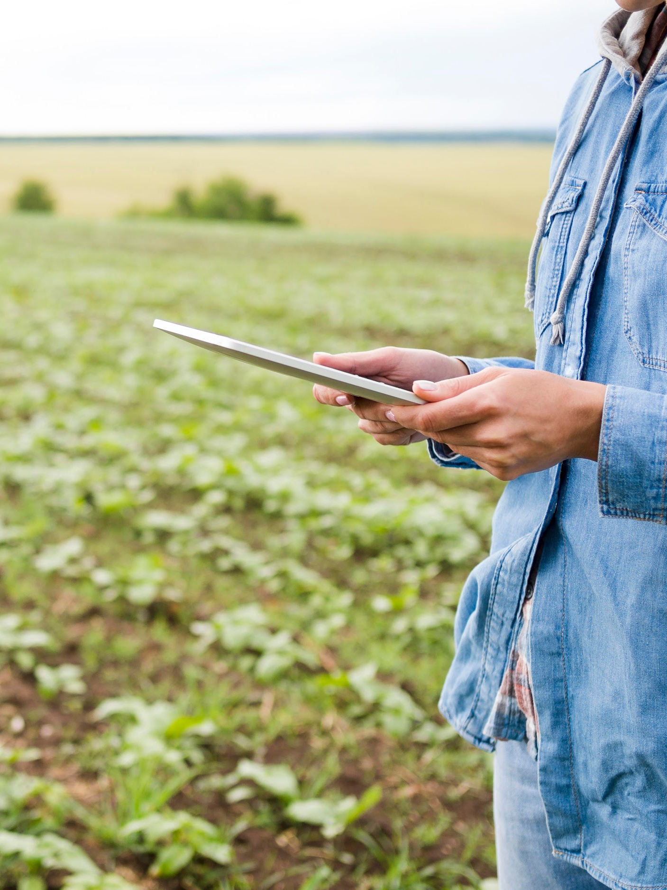
Project summary
Our solution includes 2 parts service and product part :-
IoT based device
ML Model
Website
Matnure
We focus on promoting farmers for Organic Farming, which results in good soil health and healthy vegetation for consumers.

Slide 6
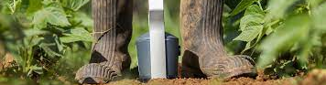
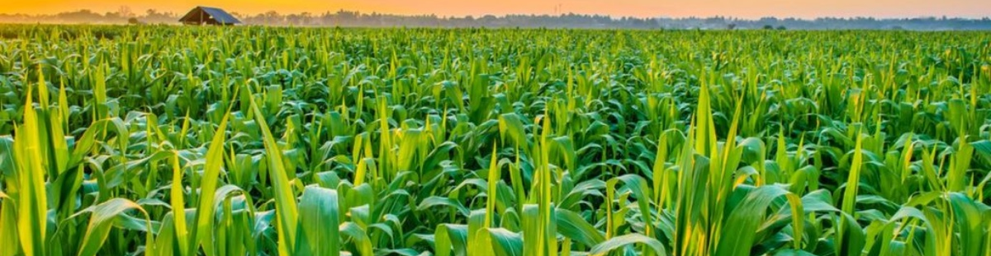
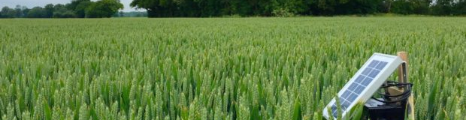
What we are working on
IoT Device
Website
Integration and Accuracy

Slide 7
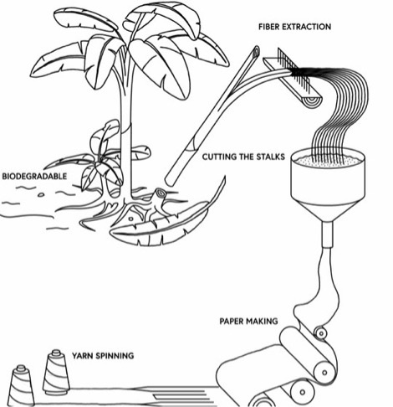
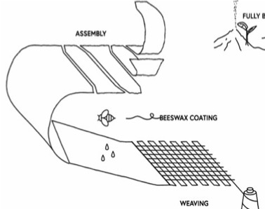
MATNURE

Slide 8
The Deal
The Deal
Service – Data consultancy, geo-mapping
Product - Organic Mulching Sheets
Government
Corporate or Large-Scale Farmers

Slide 9
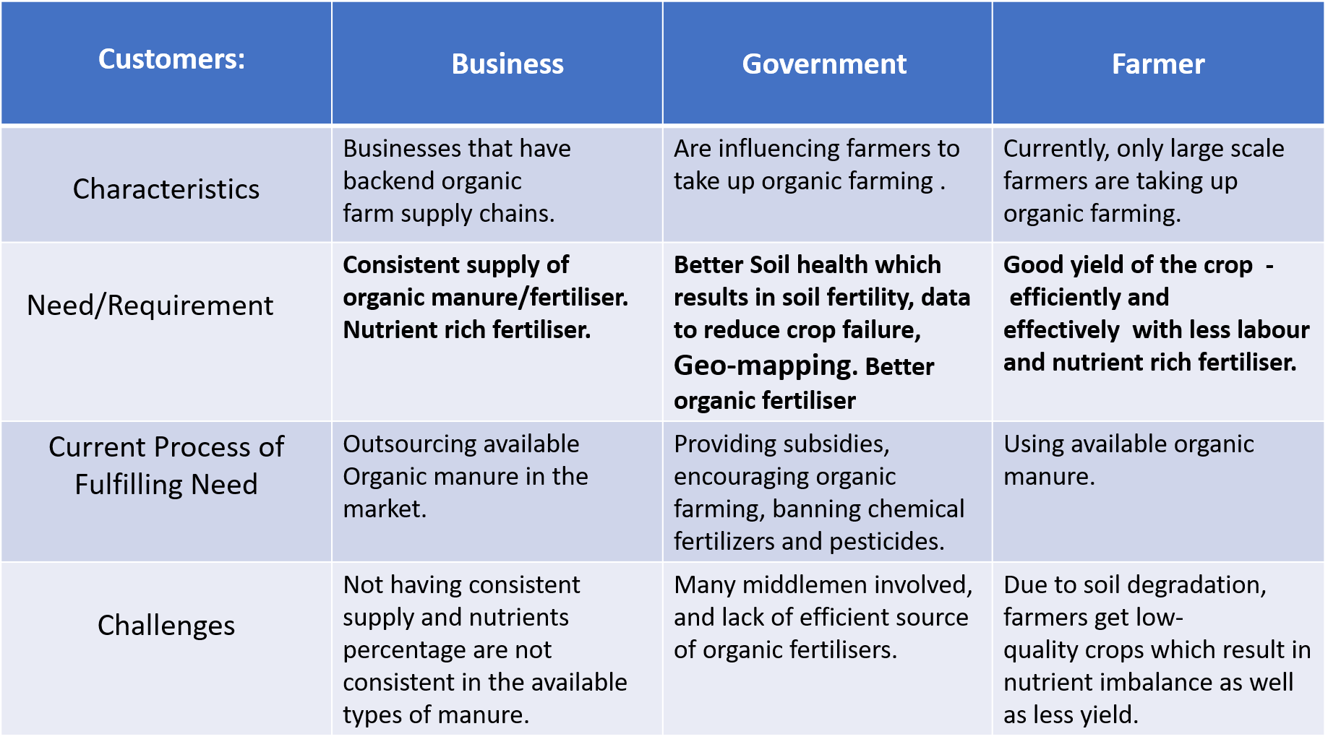
Target Customer Segment

Slide 10
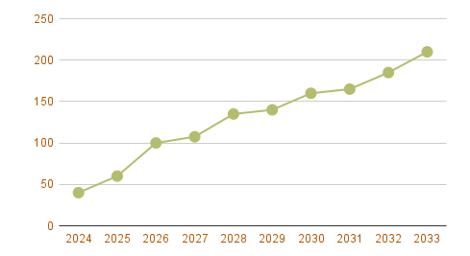
Value Proposition
1. Our MATNURE would be rich in nutrients which will help in getting high organic yield. 2. Data Driven Decision making increases crop-yield
Soil Health
Consumer’s Health

Slide 11
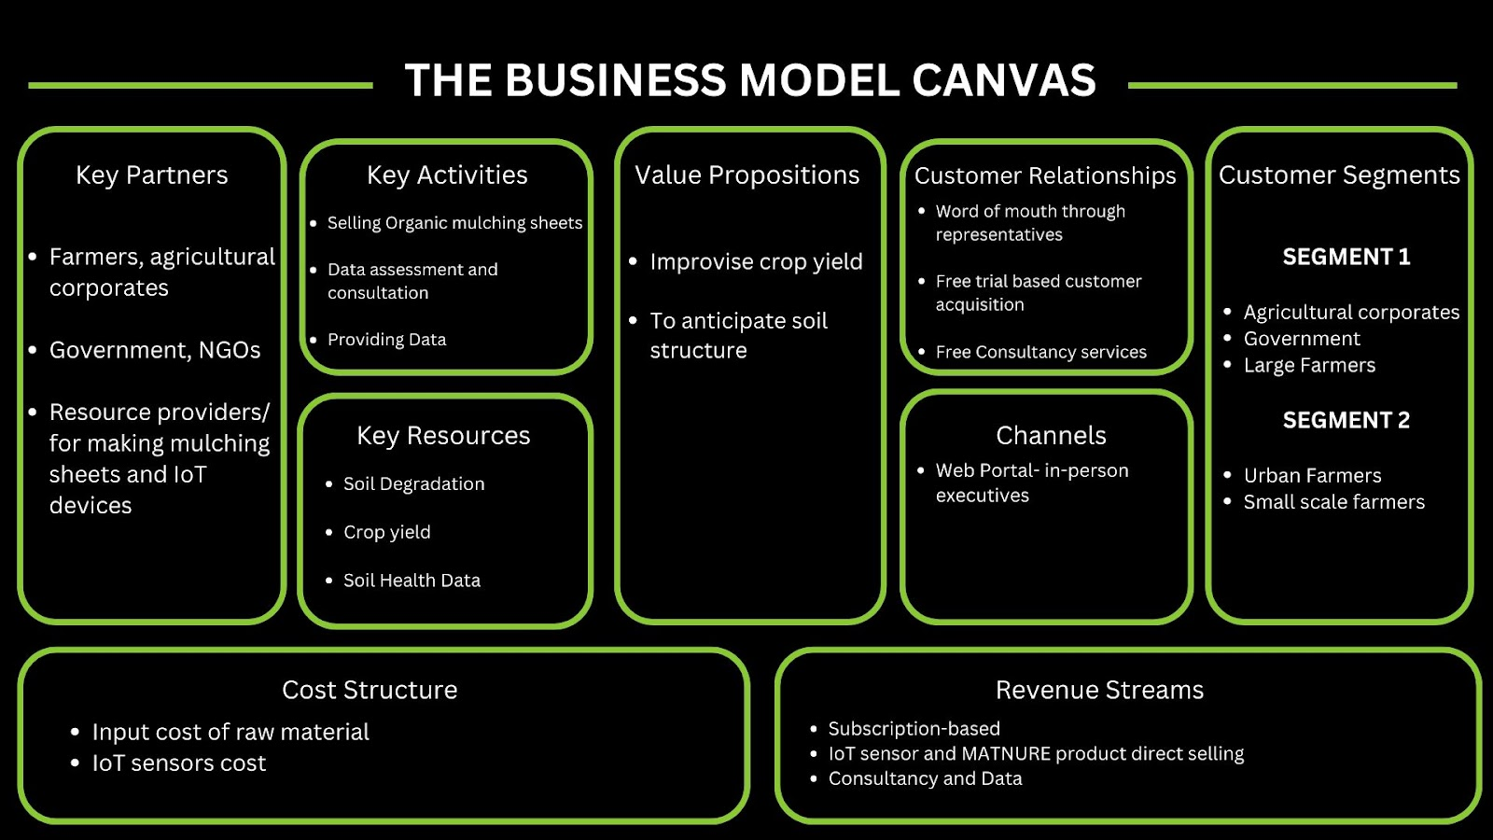
Business Model

Slide 12
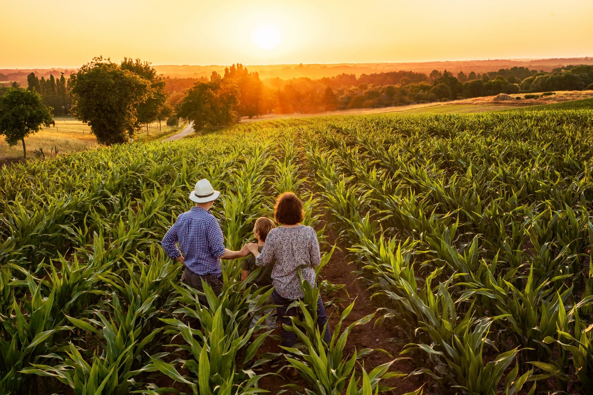
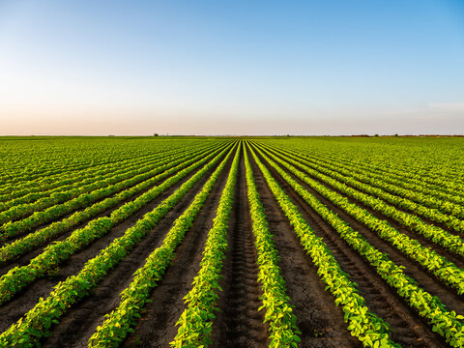
Visit our web!
MATNURE-Website

Slide 13
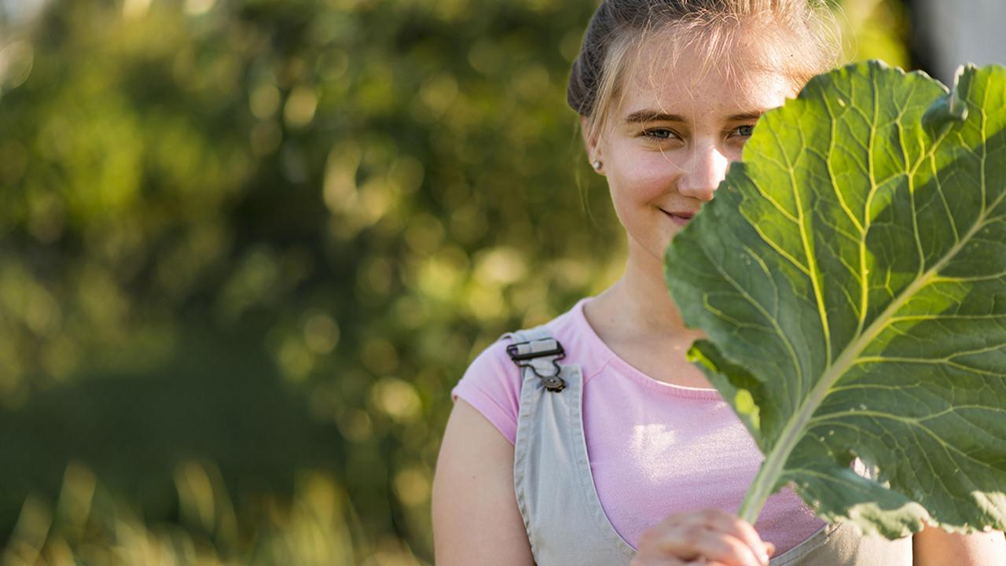
Sowing the seeds of a healthier future through organic innovation.
Thanks!

